Slide 1
Video Database Analytics
Vishwas Kalani - 2020CS10411
Aman Bansal - 2020CS10319
Supervisors :
Prof. Kaustubh Beedkar
Prof. Srikanta Bedathur

Slide 2
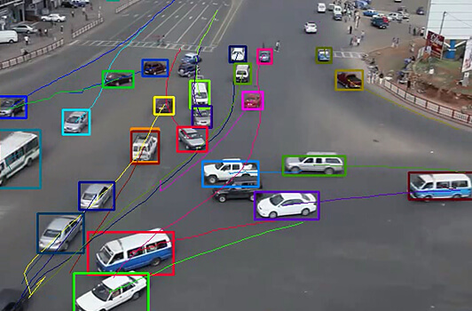
Problem Setting and Objectives
Goal
Objectives
Our primary goal is to revolutionize event detection in streaming videos by replacing the current approach of training specialized models for each query with a unified and adaptable solution
Focus on traffic videos but we are able to imagine many applications beyond that.
General purpose query system
Real time event detection

Slide 3

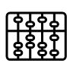
Recap of work before midterm
Object detections and tracking
Load shedding
Using manual programs
Using Static databases
This part of the project is black box for us though we are using YOLOV5 and norfair for object detection, for implementation purpose
We had set a basic heuristic. We calculate the histograms of frames, and process when they differ more than a threshold
We tried writing manual programs for detection of various events from logs but it is not scalable to write a completely different program for multiple usecases
This sort of setup would have a lot of challenges. There would be expensive join operations, when to delete the content of DB

Slide 4
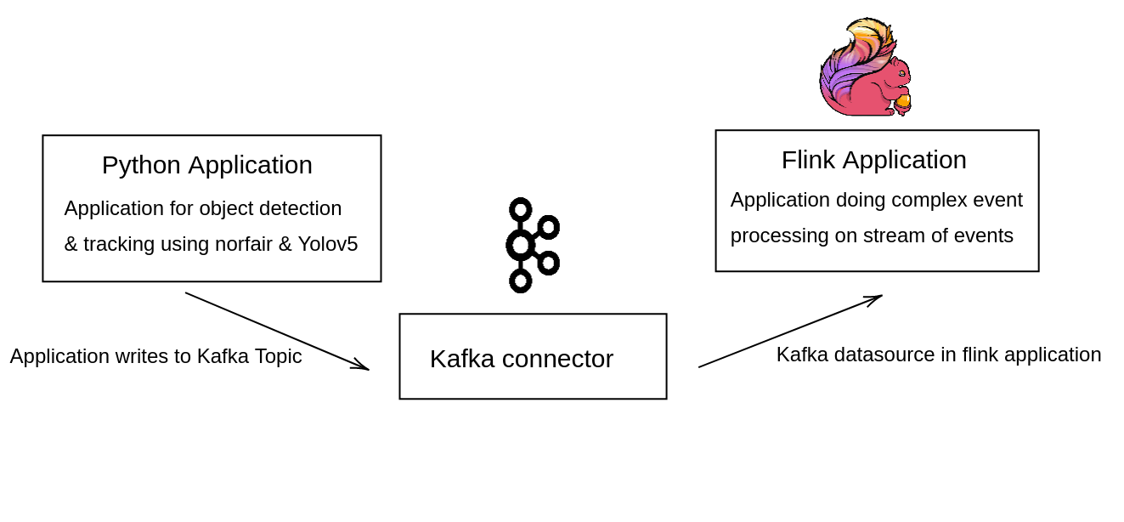

Current architecture we use
Running on edge
Running on cloud

Slide 5
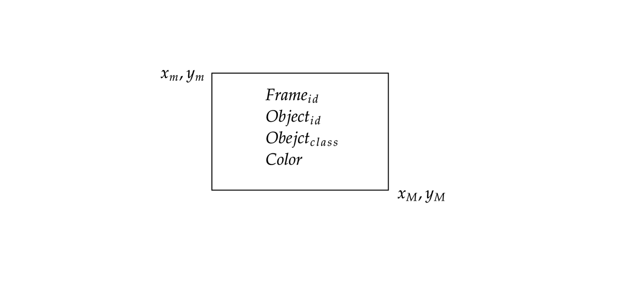
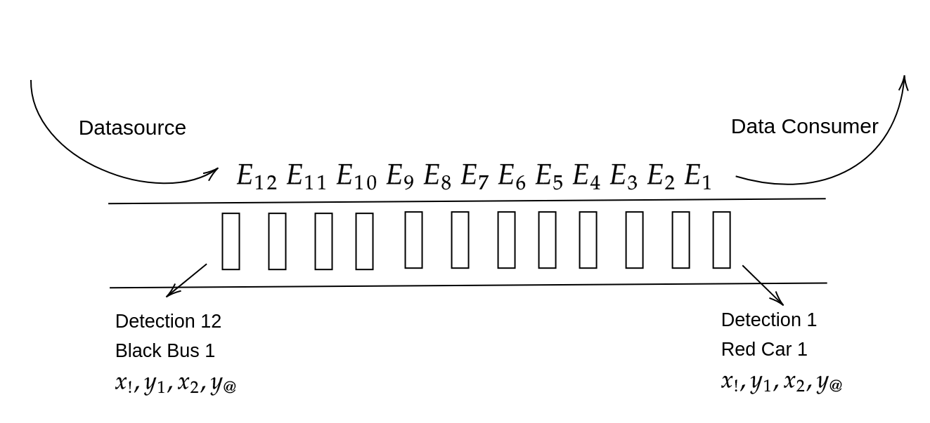
Building blocks of our approach
We define an “event” as a detection made by our model, an event has attributes as shown.
25%
35%
10%
40%

Slide 6
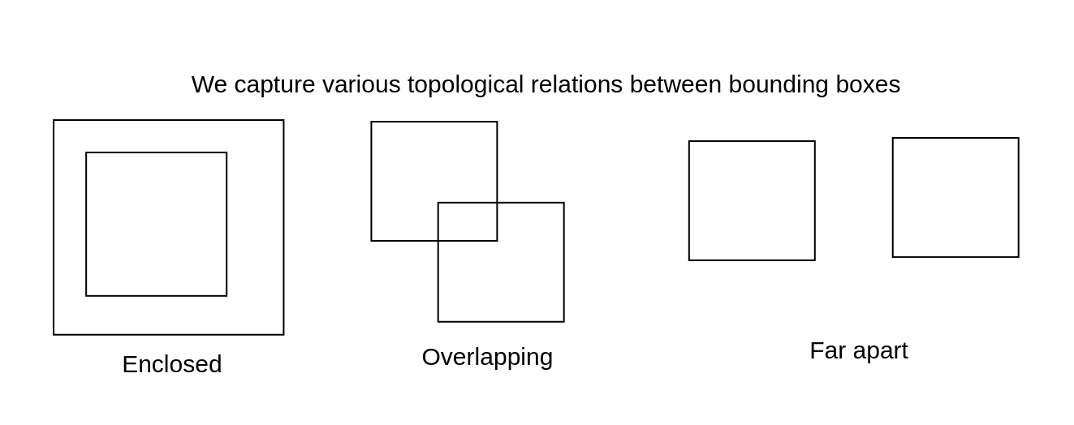
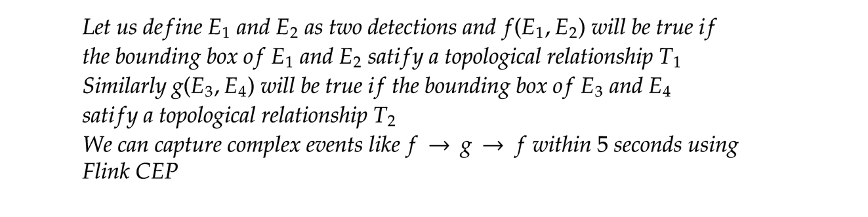
Capturing Patterns using Bounding Boxes
25%
35%
10%
40%

Slide 7
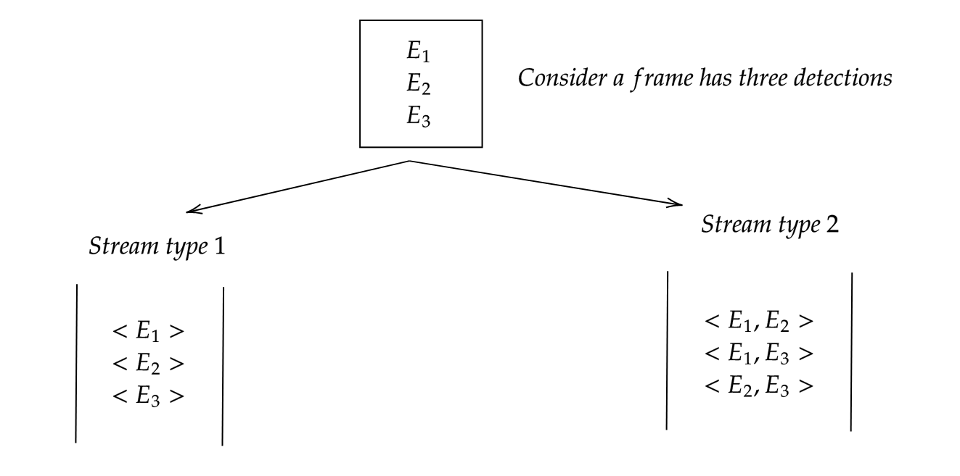
Two types of Streams
25%
35%
Merits & Demerits of Type 1
- Useful in alerting or detection queries
- Difficult and computationally more expensive to capture relation between bounding boxes
Merits & Demerits of Type 2
- Useful to capture relation between bounding boxes like overlap
- Does not generalize efficiently to any general k objects. Expensive to generate stream of n C k objects with n objects in a frame
10%
40%

Slide 8
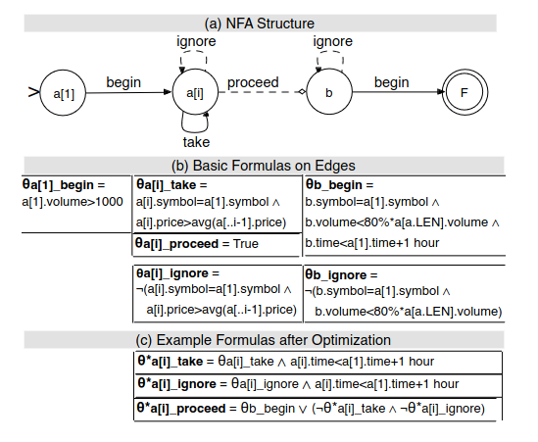
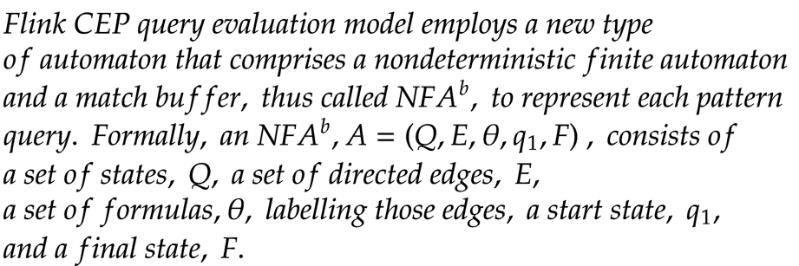
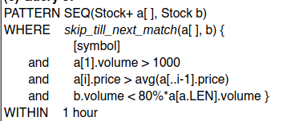
Computational Model of Flink CEP
25%
35%
10%
40%

Slide 9
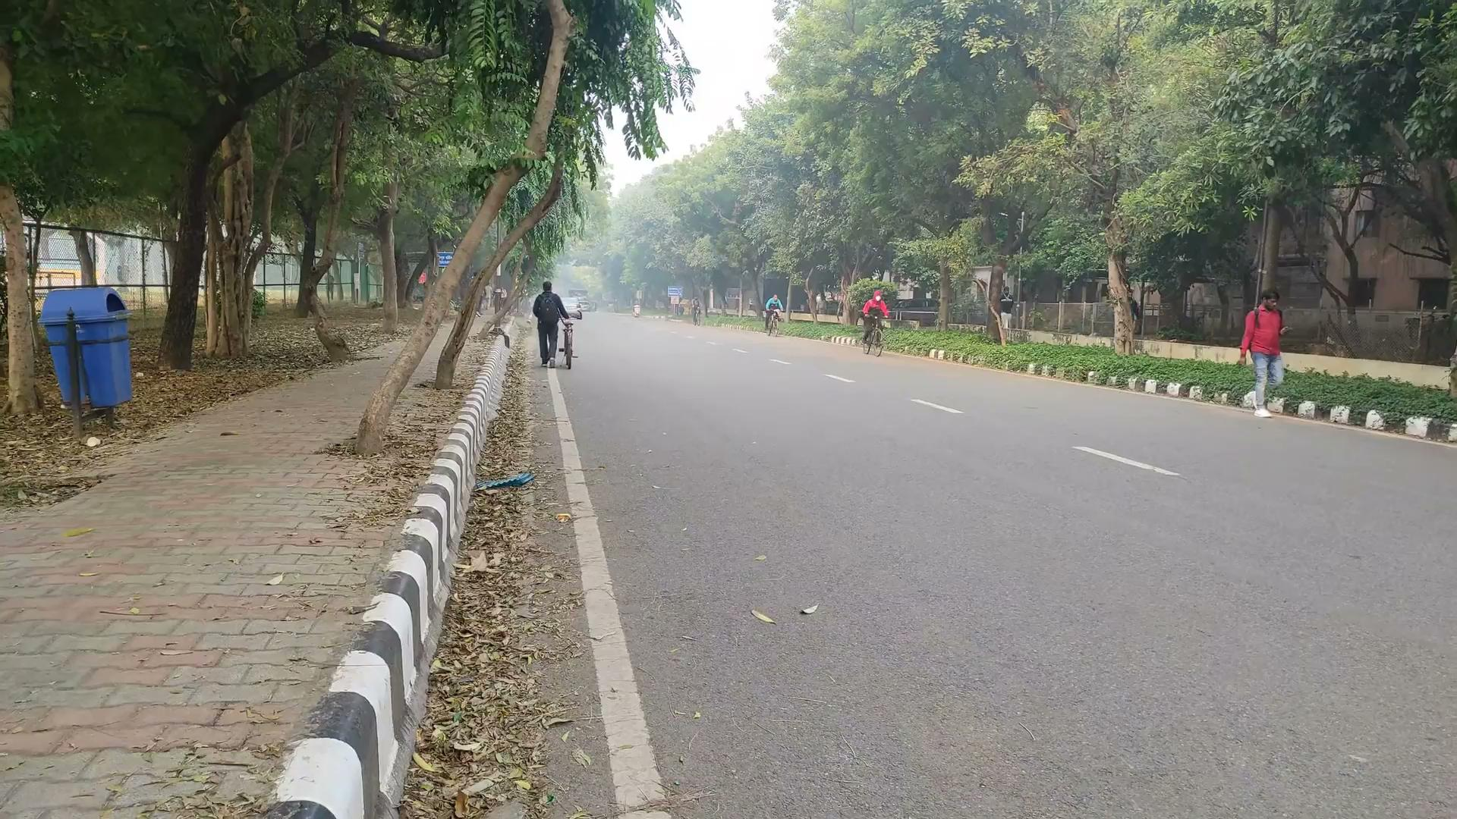
Some Example Queries
Query Purpose : To differentiate person riding bicycle and carrying bicycle
25%
35%
10%
40%

Slide 10
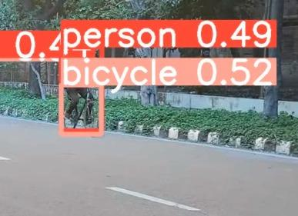
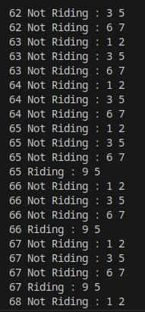
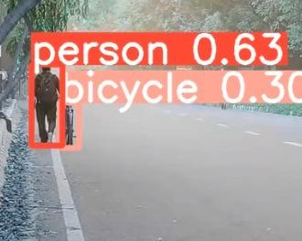

Slide 11
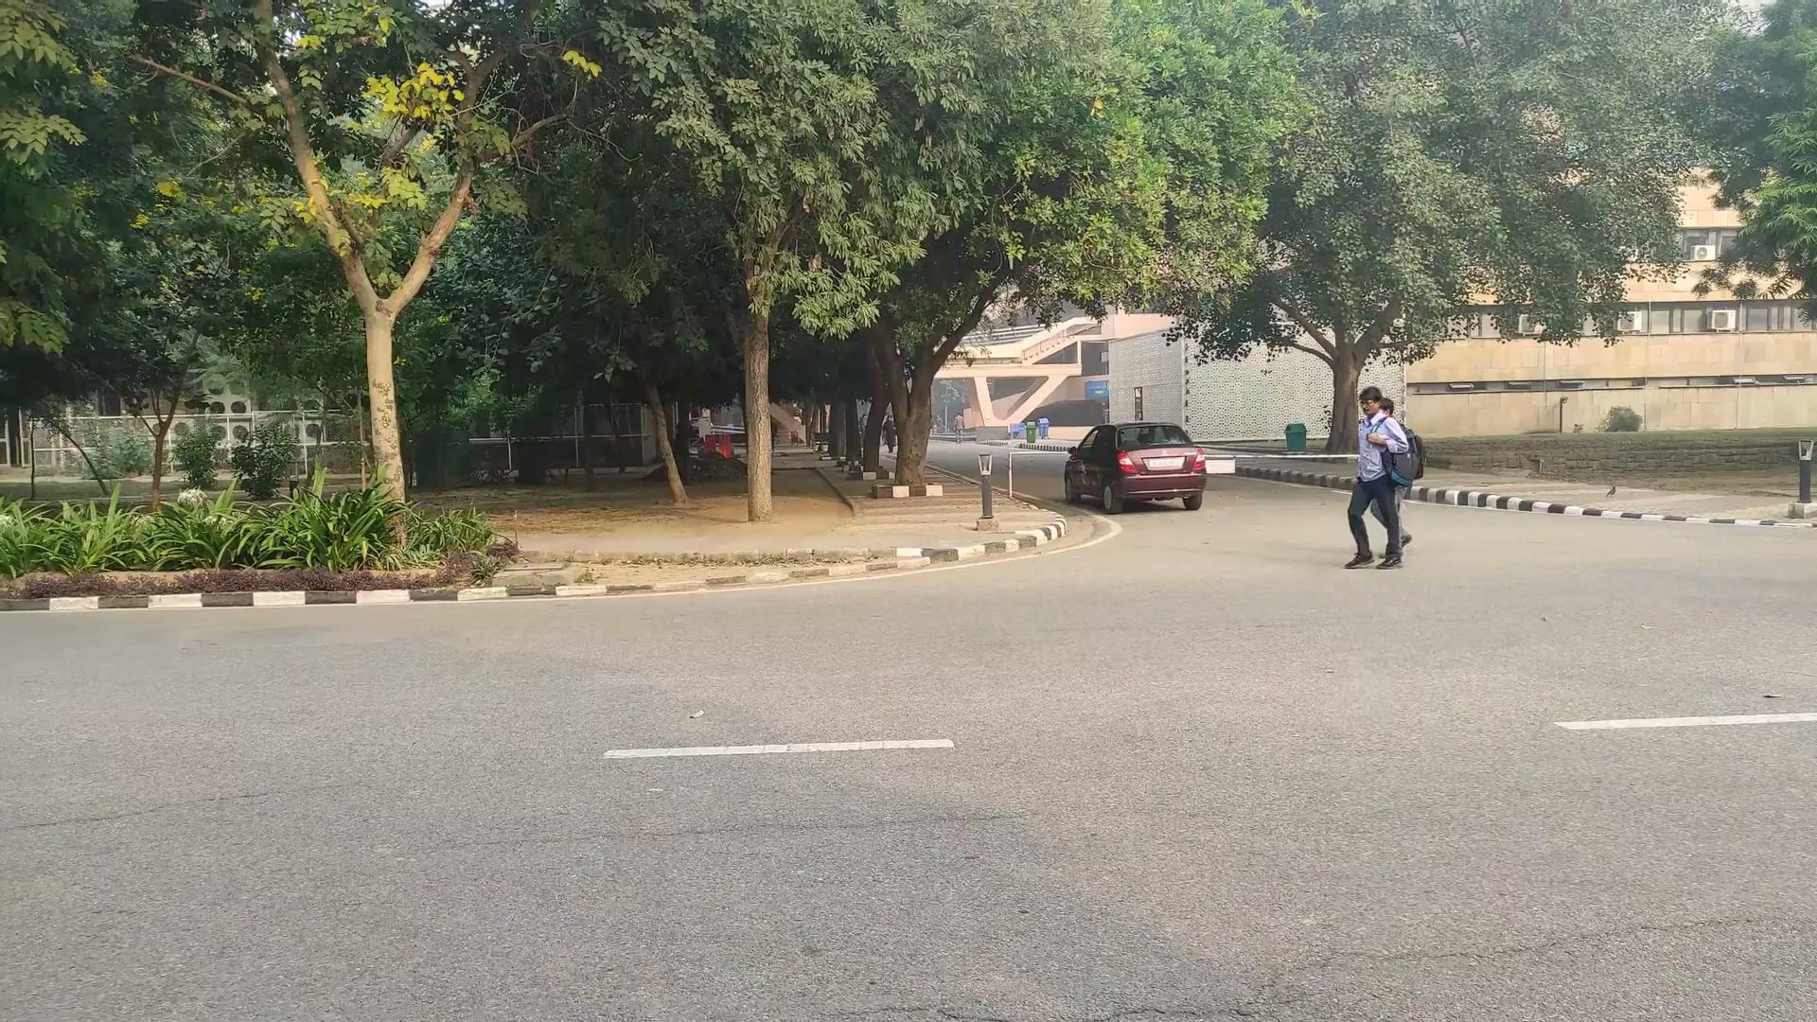
Some Example Queries
Query Purpose : To spot a person having cell phone on the road
25%
35%
10%
40%

Slide 12
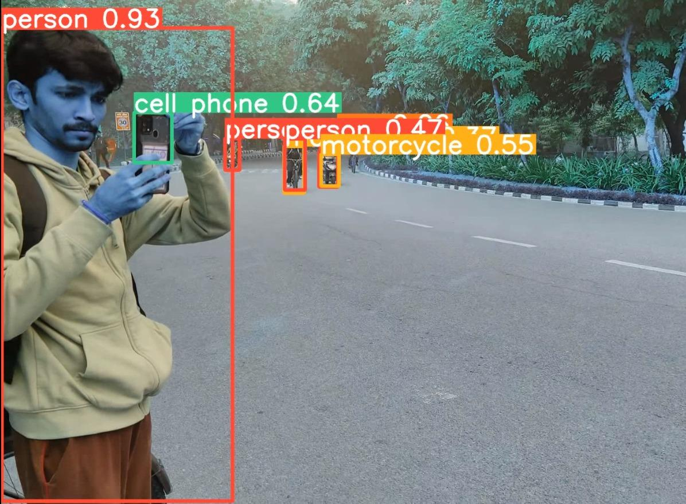
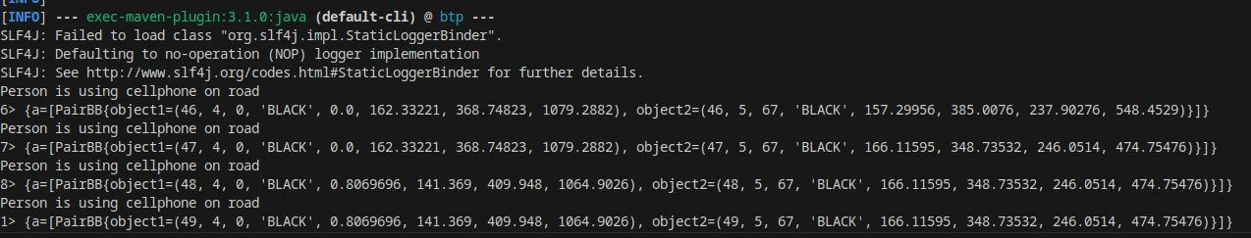

Slide 13
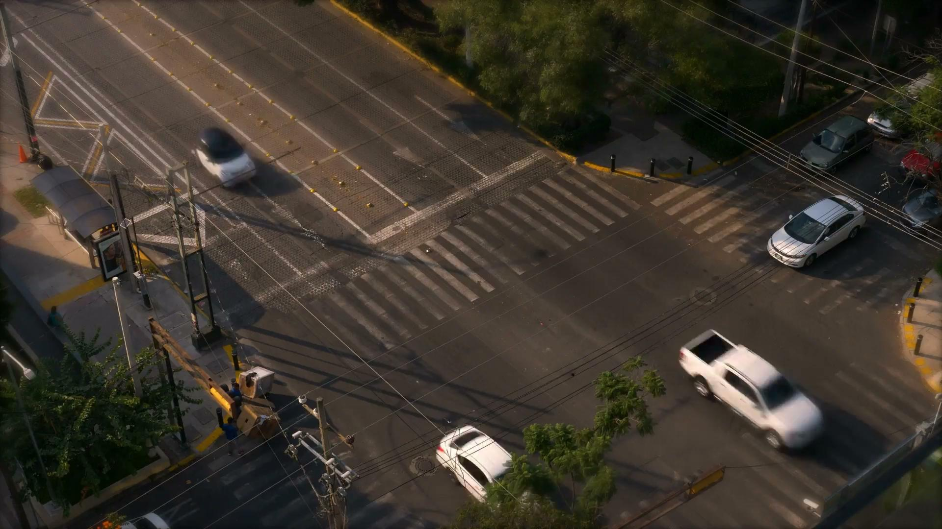
Some Example Queries
Query Purpose : To detect a car moving backwards
25%
35%
10%
40%

Slide 14
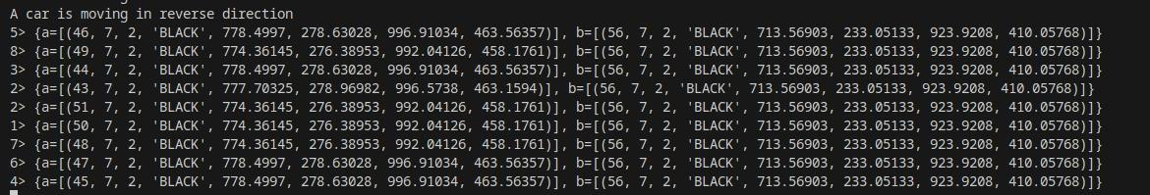
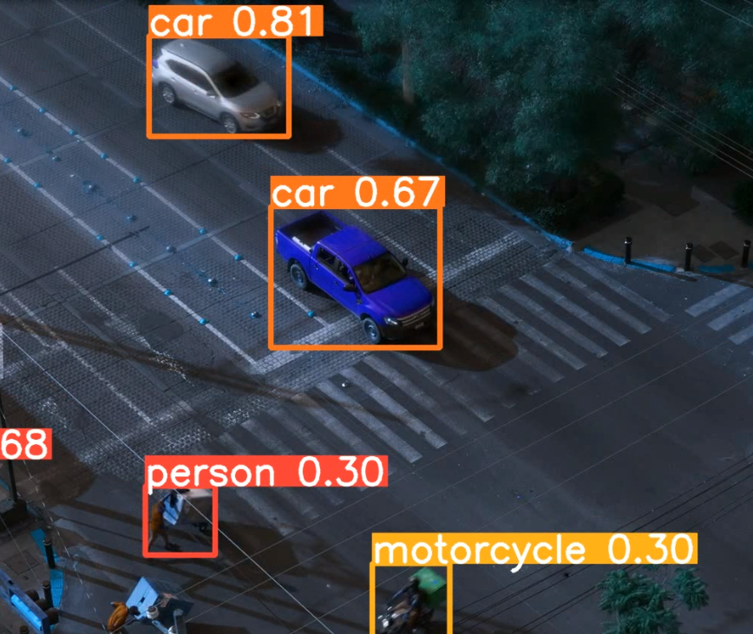
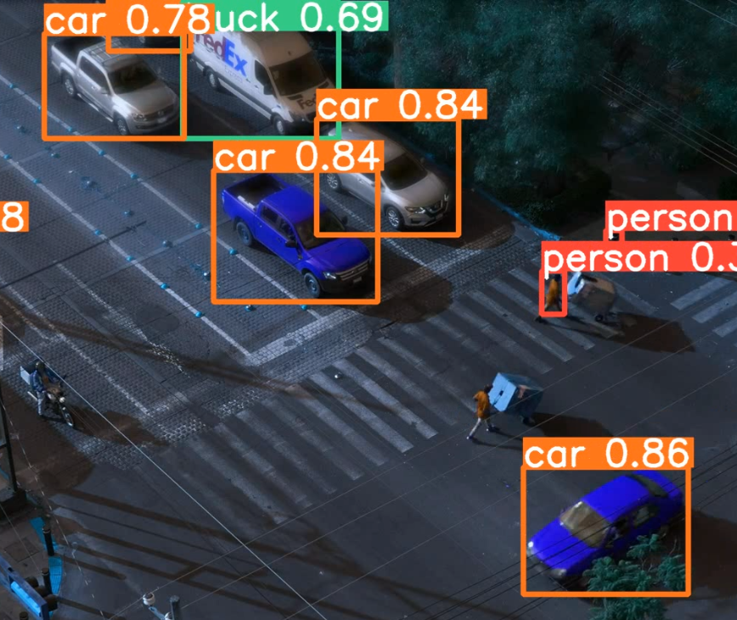

Slide 15
Resource and Papers referred
https://hparch.gatech.edu/papers/jiashen_sigmod2022.pdf : Referred this paper for load shedding, model selection techniques
https://dl.acm.org/doi/10.1145/568271.223798: Referred this paper for understanding various topological relations between bounding boxes of objects
https://github.com/tryolabs/norfair: Referred this code base for converting yolo detections to norfair detections
https://people.cs.umass.edu/~yanlei/publications/sase-sigmod08.pdf: Referred this paper for understanding computational model of flink, the pics of NFA shown has been borrowed from this paper.

Slide 16
THANKS !!

